Slide 1

Topic: Adding and Subtracting with decimals
EQ: What strategies help adding and subtracting decimals?
Mrs. McLeod

Slide 2

24
7
30
Topic: Adding and Subtracting with decimals
Date
EQ: What strategies help adding and subtracting with decimals?
Picture method
3.9 + 2.4 Using Chocolate
Each whole number is a wrapped chocolate bar (whole bar) and the tenths are pieces of the chocolate bar
+
Collecting them gives:

Slide 3
24
7
30
Topic: Adding and Subtracting with decimals
Date
EQ: What strategies help adding and subtracting with decimals?
Picture method
3.9 + 2.4 Using Chocolate
Each whole number is a wrapped chocolate bar (whole bar) and the tenths are pieces of the chocolate bar
Collecting them gives:
5 wholes and 13 tenths
10 tenths can be wrapped up to give 1 whole

Slide 4
24
7
30
Topic: Adding and Subtracting with decimals
Date
EQ: What strategies help adding and subtracting with decimals?
Picture method
3.9 + 2.4 Using Chocolate
Each whole number is a wrapped chocolate bar (whole bar) and the tenths are pieces of the chocolate bar
Collecting them gives:
5 wholes and 13 tenths
10 tenths can be wrapped up to give 1 whole
With 3 pieces still left over

Slide 5
24
7
30
Topic: Adding and Subtracting with decimals
Date
EQ: What strategies help adding and subtracting with decimals?
Picture method
3.9 + 2.4 Using Chocolate
Each whole number is a wrapped chocolate bar (whole bar) and the tenths are pieces of the chocolate bar
Your Turn:
2.3 + 1.2
1.5 + 2.4
3.6 + 2.7
4.8 + 4.7
Collecting them gives:
5 wholes and 13 tenths
10 tenths can be wrapped up to give 1 whole
With 3 pieces still left over
3.9 + 2.4 = 6.3

Slide 6
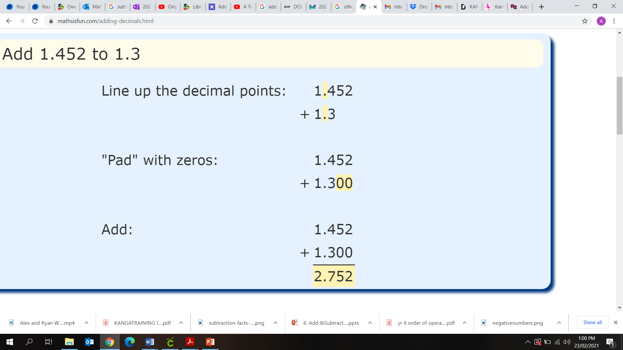
24
7
30
Topic: Adding and Subtracting with decimals
Date
EQ: What strategies help adding and subtracting with decimals?
Algorithm method
Or the “column method” can be used for all numbers large and small but particularly useful for decimals
Write down the numbers lined up in the proper place value (decimals lined up)
Put in zeros so the numbers are the same length
Then add (or subtract) each column starting on the right (make sure your answer has a decimal point)
Steps
The zero is saying “there is no value at this place value”
- in a number like 10, the zero is saying “no ones”
- in a number like 2.50 the zero is saying “no hundredths”
So we can have 2.5, 2.50 or 2.500 and they are all the SAME
However if we had 2.5 and 20.5 they would NOT be the SAME
Why can we add zeros?

Slide 7
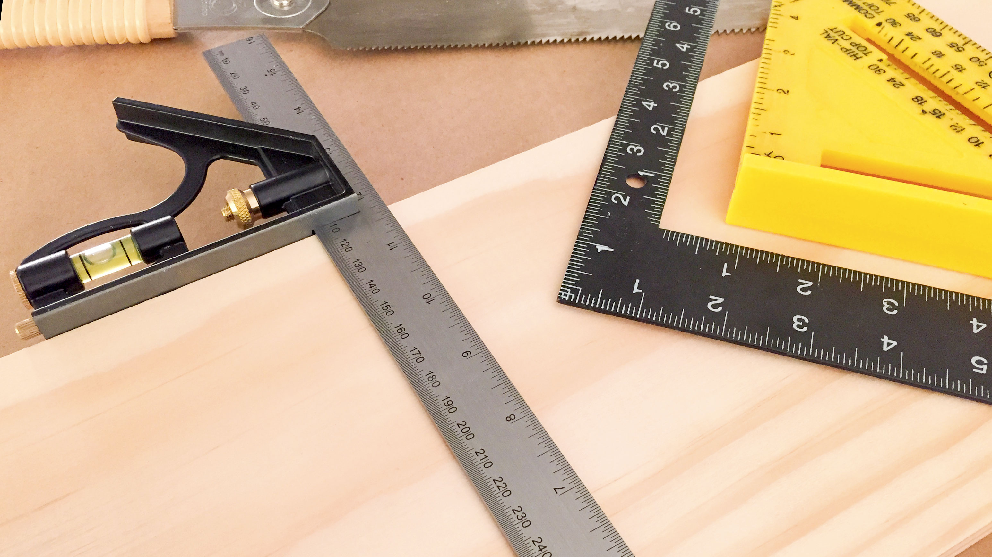
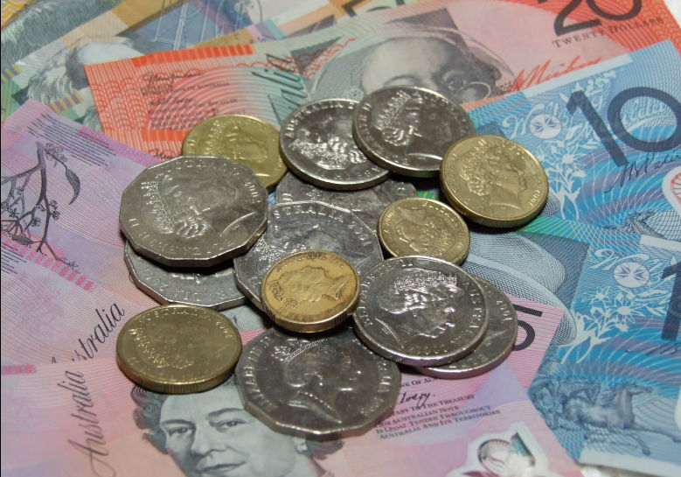



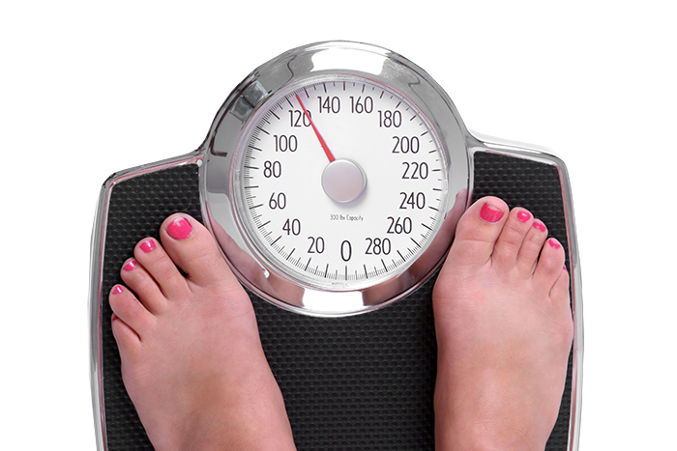
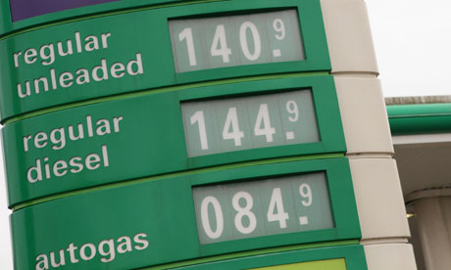
Quick Write
When might we use adding decimals in everyday life?

Slide 8
Line them up
Pad with zeros
Add/subtract from the right
Practice LHS
2.45 + 1.1
3.33 + 2.2
5.0 + 2.74
5.67 – 2.45
33 – 4.43
9.65 – 1.78
1345.37 – 25.66
78923 – 456.76
50.008 + 1342.73

Slide 9
Practice Worksheets
Fun Sums 45 (addition) and 46 (subtraction)

